Slide 1



TEAM 2
Intelligent Cognitive
Alarm Platform
Powered by the Cognitive Challenge Engine — an AI system that
generates fresh brain puzzles on demand.
BE ALERT
NASRITHA
→

Slide 2

INTRODUCTION
What Is This Project?
The Cognitive Challenge Engine generates brain puzzles for the user to solve. It started as a mind map with one central idea, connected to 7 challenge categories:
MATH
LOGIC
MEM
WORD
Mathematical Problems
Logic Puzzles
Memory Challenges
Word Games
Arithmetic, percentages, algebra
Number patterns, reasoning, missing elements
Memorize & recall words, sequences, positions
Unscramble, synonyms, antonyms, vocabulary
PATT
RIDL
QUIZ
Pattern Recognition
Riddles
Quick Quizzes
Shape, color, and number patterns
Short reasoning riddles
General knowledge and science
LUCID · Cognitive Challenge Engine
2

Slide 3
THE PROJECT SO FAR
What Has Been Built
A complete working demo has been built with three main parts, all working together right now — using AI to generate endless fresh questions instead of a fixed, repeating list.
01
02
03
The Brain (AI Part)
The Backend (Server)
The Frontend (What Users See)
Talks to Google's Gemini AI and asks it to invent a new question for a chosen category and difficulty level.
Receives requests, talks to the AI, sends the question back, and checks if the user's answer is correct.
A webpage showing 7 categories around a central engine — shows questions, takes answers, gives instant feedback.
LUCID · Cognitive Challenge Engine
3

Slide 4
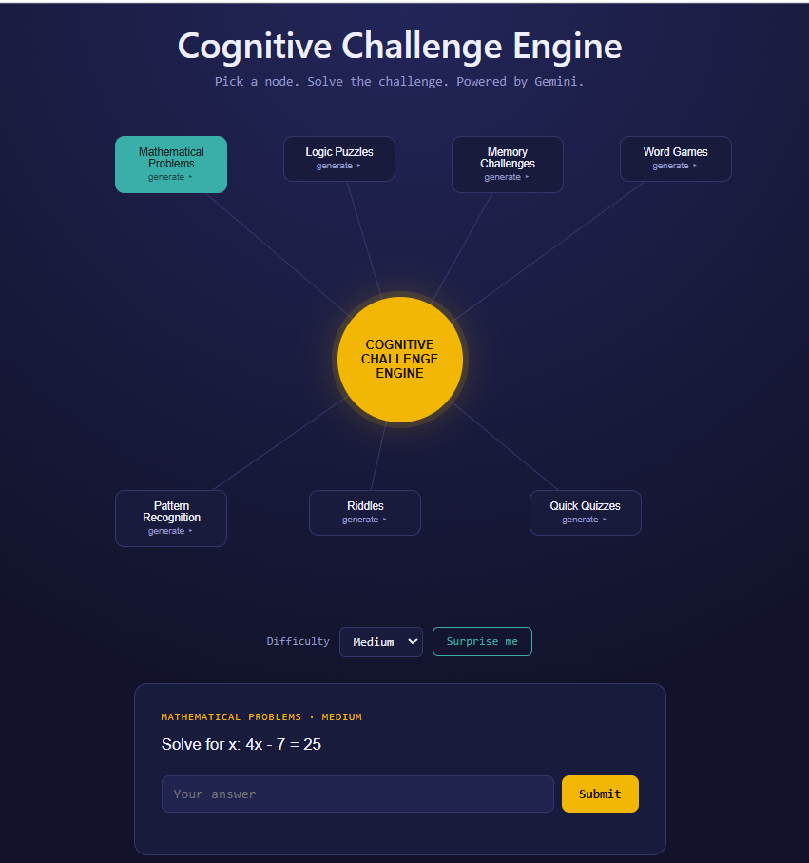
SEE IT IN ACTION
The Demo, Live
This is the actual working demo. It mirrors the original mind map exactly:
The glowing center circle: ‘Cognitive Challenge Engine’ — click it for a random challenge.
7 category nodes: One click on any node (like ‘Mathematical Problems’) requests a fresh question from Gemini AI.
Difficulty dropdown: Easy / Medium / Hard — changes how simple or complex the question is.
The question card: Shows a live example: ‘Solve for x: 4x − 7 = 25’ at Medium difficulty, with an answer box and Submit button.
LUCID · Cognitive Challenge Engine
4

Slide 5
THE WORKFLOW
How It Works, Step by Step
1
User clicks a category (e.g. Math) with a difficulty (e.g. Medium).
5
Gemini generates a fresh question, answer, choices (if any), and a short explanation.
2
The webpage sends this request to the backend server.
6
The backend stores the answer safely on the server and sends only the question to the webpage.
3
The backend picks a random sub-topic and looks up what that difficulty means for this category.
7
The user answers, and the server checks it and replies: correct or incorrect, with an explanation.
4
The backend sends detailed instructions to Gemini AI, including a random seed for variety.
LUCID · Cognitive Challenge Engine
5

Slide 6
UNDER THE HOOD
Tools and Technologies Used
Part | Tool Used | What It Does
Question generation | Google Gemini AI (gemini-3.5-flash-lite) | The AI model that invents each question, its answer, and an explanation.
Backend server | Python + FastAPI | A lightweight web server that handles requests and talks to the AI.
Frontend (webpage) | HTML, CSS, JavaScript | Draws the puzzle map, shows questions, sends answers to the server.
Communication format | JSON | A structured text format used to pass data between all the parts.
In short: Python runs the server, FastAPI makes the web server easy to build, and Gemini is Google's AI model that creates the actual puzzle content.
LUCID · Cognitive Challenge Engine
6

Slide 7
EXAMPLES
What Sample Questions Look Like
These are examples, not fixed questions — the AI creates new ones like this every time.
Category | Example Question | Example Answer
Mathematical Problems | What is 15% of 60? | 9
Logic Puzzles | What comes next: 2, 4, 6, 8, ? | 10
Memory Challenges | Memorize: apple, chair, river, lamp. What was the 3rd word? | river
Word Games | Unscramble this word: NELIST | LISTEN
Pattern Recognition | Circle, Square, Circle, Square, ? | Circle
Riddles | What has hands but cannot clap? | A clock
Quick Quizzes | Which planet is known as the Red Planet? | Mars
LUCID · Cognitive Challenge Engine
7

Slide 8
EASY / MEDIUM / HARD — NEVER REPEATING
Difficulty Levels & Fresh Questions
Specific rules define what each difficulty means per category — and the server adds randomness so the same click never gives the same question twice.
Category | Easy | Medium | Hard
Math Problems | Numbers under 20 | Two-digit numbers, one-step algebra | Multi-step arithmetic or algebra
Word Games | 4-5 letter word | 6-8 letter word | 9+ letter word
Memory Challenges | 3-4 items | 5-6 items | 7-8 items
Staying fresh: the server (not the AI) randomly picks the sub-topic each time, and adds a random seed to every request — telling the AI to invent new numbers and words instead of repeating a previous question.
LUCID · Cognitive Challenge Engine
8

Slide 9
GETTING STARTED
How the Demo Is Run
Install the required Python tools (FastAPI, the Gemini AI library, and Uvicorn).
1
Get a free API key from Google's AI Studio website.
2
Save that key so the program can use it, then start the local server with one command.
3
Open the webpage in a browser to use the demo.
4
No payment or credit card is needed — Google's free tier is sufficient for building and testing.
LUCID · Cognitive Challenge Engine
9

Slide 10
FUTURE SCOPE
Possible Next Steps
Connect to the Flutter App
Save Progress
Wire this backend into the Lucid Flutter mobile app, so the alarm screen calls these APIs directly for its puzzles.
Add a database to track scores and history over time.
Smarter Answer Checking
User Accounts & Leaderboards
Accept close variations in answers, especially for math and riddles.
Let multiple users track their own scores and compare with others.
LUCID · Cognitive Challenge Engine
10

Slide 11
CONCLUSION
From Mind Map to Working Demo
Starting from a simple hand-drawn mind map, a fully working demo has been built — using Gemini AI to generate fresh puzzles across all 7 categories, a Python FastAPI backend, and a webpage matching the original design. This same idea powers real products too: brain-training apps, alarm-clock apps like Lucid, and educational practice tools.
The project is currently a working local demo, with a clear path to connect it to the Flutter app and grow it into a full product.
LUCID — Wake Up. Learn. Achieve.

